Slide 1
Air Quality
Climate change studies in Southern Africa need to include wind-eroded dust particles
There is a need for a common platform or the integration of data between various platforms to share air quality and meteorological data nationally and within SAWS.
More work is needed on understanding the dynamics, interaction and contribution of anthropogenic emissions and natural emissions.
More work is needed on understanding the regional characteristics of pollutants.

Slide 2
Aviation
The SAWS developed an easy to interpret colour-coded Thunderstorm Table that uses radar tracks to monitor the risk of thunderstorms at airports.
A lightning monitoring and alert system was also developed for airports which uses observed lightning information to send out alerts for airports.
SAWS will continue to participate in the WMO AvRDP project and also have plans to roll-out additional products to airports during the coming year.
Low cloud and poor visibility at OR Tambo occur frequently between March and August
OR Tambo is category 2 airport which means that visibility reach 300m the airport cannot operate
These occur between 4am-7am in summer and 5am-8am in winter

Slide 3
Aviation continued
Mountain wave study
Severe turbulence in spite of low energy waves
The ATM System seeks to engage the ATM Community as appropriate with the aim of achieving best business and safety outcomes.

Slide 4
Public Weather Service
Collaboration: SAWS and NDMC
Develop matter-of-fact communication to all users from a threshold based forecast (how much rain is falling) to an impact based assessment (what will this much rain mean to your community)
Works as an end-to-end collaboration between SAWS, disaster management and stakeholders
Launch planned for mid-May
Need to still include GIS-based vulnerability data
And need to verify these warnings to ensure robustness of the system

Slide 5
Public Weather Service continued
Challenge: Bridging the gap between ‘scientists’ and ‘high risk communities’ in the dissemination of critical information for imminent threats.
Was done in collaboration with Disaster Management officials from all 3 spheres of Government
Clear understanding of roles and responsibilities between DM and SAWS officials
Supports and guides the Decision Making process in DMC;
By understanding impact, we can better prepare our response strategy;
DM officials provide on the ground feedback to SAWS to confirm impacts and ground truthing;

Slide 6
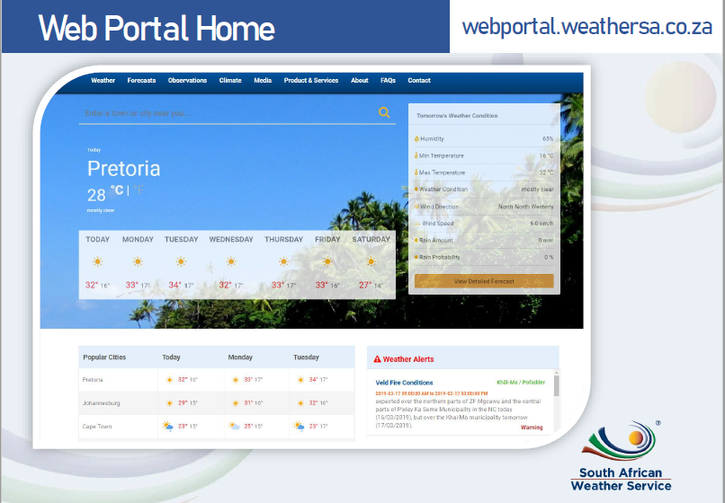

Slide 7

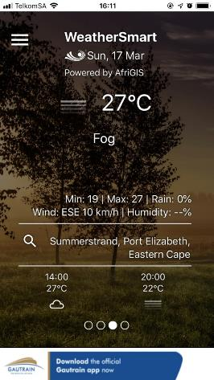

WeatherSMART
Animated Background
Current Conditions
Intra-day Forecast
Current Location

Slide 8
Marine

